Slide 1









European seminar
25th of January 2023

Slide 2
Agenda
Reminder of the project
Presentation of European project partners
Presentation of the members of the Val d’Oise Territorial Group
Process of detecting the professional gestures identified in relation to the selected trades
Beneficiaries of the micro-training courses
Method of measuring the « delta » at the entrance to micro-training
Synthesis and closure of the work

Slide 3
1. Background of the project
Reminder of the objectives :
1. To enable the long-term unemployed (LTU) to acquire valuable skills through theprovision of short-term training in order to reintegrate them socially and professionally and to give them the desire to learn to learn.
2. To propose a complementary tool (micro-training and support for LTUs
The aim of SKY is to integrate the micro-training method into a progressive pathway of (socio)professional reintegration.

Slide 4






2. European partner of the project

Slide 5
3. Val d’Oise Territorial Groups
The SKY project is based on the establishment of Territorial Working Groups (TWGs) mobilising to create tools to promote the acquisition of skills through micro-training
The AGFE mobilises the PLIE (Local Multiannual Plans for Integration and Employment) to set up the TWGs
The PLIEs aim to provide access to sustainable employment for people excluded from the labour market. The PLIEs offer
    individualised and reinforced support for the public, with no time limit;
    This support is long-term and takes into account the whole person;
    It is provided by individualised pathway referents and continues for the first six months of access to sustainable employment.

Slide 6


3. Val d’Oise Territorial Groups
Local Plan for Integration and Employment (PLIE)
https://www.europlie.asso.fr
The aim of a PLIE is to enable vulnerable groups (low level of qualifications, very long-term unemployment, migrants, etc.) to access and return to employment in its territory.
The choice of relying on two distinct territories through the PLIEs to deploy the approach implemented in the framework of the SKY project has two objectives.
The first objective is to rely on a wide range of partners in order to enrich the approach
The second objective is to broaden the integration offer of the PLIE in terms of building integration pathways based on the micro-trainings that will have been produced by the project

Slide 7
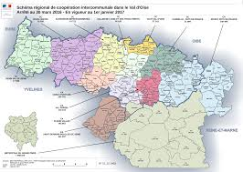

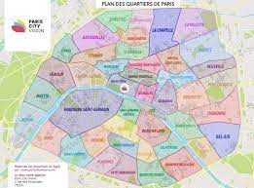
3. Val d’Oise Territorial Groups
Val d’Oise

Slide 8
3. Val d’Oise Territorial Groups
27 people participated: 20 different organisations
Public Employment Service : Pôle Emploi, MDE Roissy Pays de France – UNISAP, Mission Locale
Entreprises : SUEZ Rebond, MMS France (ICT), Employer cluster Aide à Domicile 95, Kangourou Kid, la MFPass*
Training organisations : Greta Val d’Oise, AFPA, Assist’Famille
Solidarity associations : EQUALIS, ESPERER95, ARS95 et EBE CESIL
Environnement association : ETRE
Local Public Body : Commune de Cergy, Agglomération de Roissy pays de France,
* Mutualité Française Publique Action Santé Sociale Centre de la Gabrielle

Slide 9

3. Groupes Territoriaux du Val d’Oise
30 best practices propositions:

Slide 10
3. Val d’Oise Territorial Groups
TWG
- Cergy-Pontoise
- Roissy Pays de France
3 trades seleted
1. Sorting and valorisation of textile waste
2. Personnal assistance
3. Computer installation
3 micro-training groups
6 skills

Slide 11
4 steps:
Jointly identify the trades with high level job pressure
Identify a maximum of 2 skills per trade
Identification of the delta
Micro-training engineering
4. Process of detection of the identified professional gestures in relation to the selected trades

Slide 12
Step 1 : Jointly identify the trades with job pressure
The first step was to meet a panel of companies and stakeholders operating in the same professional field in order to jointly determine the occupations in tension (those not regulated by compulsory qualifications).
4. Process of detection of the identified professional gestures in relation to the selected trades

Slide 13
4. Process of detection of the identified professional gestures in relation to the selected trades
Step 2 : Identify a maximum of 2 skills per trade
For each defined and approved occupation, the micro-training groups consulted either ESCO or Directory of Trades and Occupations to identify a maximum of 2 skills that seemed most relevant to the trade.
For each trade, the 2 selected skills are then proposed to companies for their opinion and validation.
An exchange of views is carried out between the training/employment organisation and the potential employers to define the skill to be taken.

Slide 14
4. Process of detection of the identified professional gestures in relation to the selected trades
Sorting waste
ARS 95
La FABRICA
Personal assistance
Assist-famille Formation
GEIQ Aide à domicile 95
Installation of a computer workstation
MMS Informatique
GRETA
Organisme de formation à désigner
EBE CESIL
Meeting January 17th 2023
Meeting January 13th et 21st 2023
Meeting in February 2023
3 Micro-training groups
30 best practices

Slide 15
Micro-training group: Installation of an operational or ready to use computer workstation
Reminder of the choice of skills :
The skill of installing a computer workstation is an important and growing need in the IT departments of large companies, public services and also concerns SMEs, associations and individuals.
The two proposed skills are taken from the TAI Referential: IT Support Technician, RNCP title of the Ministry of Labour, Sheet RNCP225.
NSF code(s): 326r : Computer assistance, software and network maintenance
Formacode(s) : 31051 : Maintenance computer assistance
ROME : I1401 - Computer and office automation maintenance

Slide 16
Micro-training group: Installation of an operational or ready to use computer workstation

Slide 17
Micro-training group : Installation of an operational or ready-to-use computer workstation
Recherche du consensus entre les 3 acteurs du projet de micro-certification
Employer : presentation of the prescribed tasks | Worker or learner : gestures performed | Training organisation: learning scenario
Prescribed tasks: Objectives Expected results Indicators of success | Gestures performed: (points à questionner selon l’annexe méthodologique SKY) Prescribed goals in relation to personal singularities The "how to do" according to usual practices and individual approaches (flow chart, procedure chart, organisation chart, etc.) The logical process of realisation (logical sequence of actions or chain of activities) and the individual adaptations The context of impleentation and the particular conditions The postures to be taken and personal adjustments Ergonomic constraints and personalised corrections Safety and hygiene rules and habits Associated knowledge (literacy, numeracy and computer skills) | Scenario / sequences / time / observation : Formalization in the form of sentences synthesizing the prescribed and the achieved. S1 Objectives Actions to be carried out Criteria for success Evaluation S2 ...
Sources : Work instructions Job cards Operating procedures Quality manual HSE (Health, Safety and Environment) regulations | Sources : Video of the situation and professional practices Manufacturers' manuals and documentation Assembly and installation documents and guides Safety instructions and recommendations | Sources : Existing frameworks Existing training programmes Available educational resources
Observations : What should be included in the context and framework of the work situation (room, temperature, other people passing by, possible nuisances, risk of electrocution, etc.)? | Observations : Filmed situation The annex recommends a strong contextualisation of the gestures to be performed | Observations : The annex recommends a formalisation towards fun, stimulating learning situations, facilitating recognition and support for learning, access to employment

Slide 18

Micro-training group: Use of a patient lift and a sit-to-stand device
Professional sector of activity | Personal Assistance Service at home or in an institution for the disabled (EPHAD)
Objectives | Professionalise and develop the skills of jobseekers to enable them to return to employment

Slide 19
Micro-training group: Use of a patient lift and a sit-to-stand device
Reminder of the choice of skills
The skills Use of a personal lift and a sit-to-stand device is an important need in the personal assistance sector.
The two proposed skills are taken from the CCP 2 reference document "Accompanying the person in essential daily activities" of the Family Life Assistant title (ADVF).
Code(s) NSF : RNCP35506 - TP - Family Life Assistant
ROME : K1302 - Assistance to adults

Slide 20
Micro-training group: Use of a patient lift and a sit-to-stand device
Working method: "The professional gesture is not written from an action verb in a constructed sentence, but is the result of a compilation of words, phrases, anecdotes which will then be formalised and used to make the micro-training programme" (p.7, Guide Sky phase 1: Extract from the methodological annex).
Procedural guide : Alcum example
Survey of 12 GEIQ member companies
Filmed practical application
Common module ok knowledge of the person and his/her environment

Slide 21
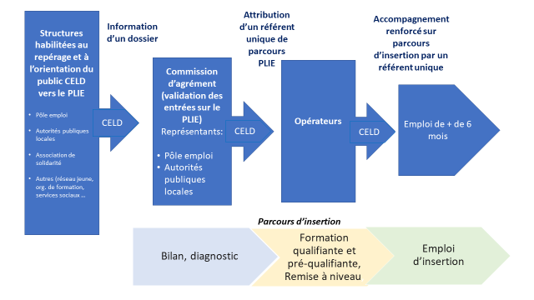
5. Beneficiaries of the short micro-trainings
Entry into the PLIE is a voluntary act by the participant, who is then assigned a single pathway referent, whose tasks are:
to establish a diagnosis of the participant's skills, difficulties and expectations
to co-construct the integration pathway with the participant and to coordinate the various stages
then to ensure follow-up in employment during the first six months

Slide 22
6. Méthode de mesure du « delta » à l’entrée sur les micro-formations

Slide 23
Professional gestures
Identify the professional gestures of a trade with the workers themselves (description of the work, how it is done, tools and materials used, necessary knowledge, operating rules, photos, video, etc.)
Select 2 professional gestures that are particularly representative of the trade (essential for starting out)
Describe and/or represent the pedagogical objectives of the 2 professional gestures (levels of knowledge and practice, tools, equipment, safety, risks, photos, videos, drawings, etc.)

Slide 24
Individual abilities (1/2)
Present the 2 professional actions to the candidates (purposes of the actions, descriptions, diagrams, photos, videos, tools used, work environment, documents, constraints and rules, etc.)
Ask the candidates to explain the 2 professional actions in their own way and by association of ideas (similar experiences, informal practices, hobbies, curiosity, etc.)
Discuss with the candidate his/her representation of the job and the 2 professional gestures (interest, desire to try, attraction, willingness to invest, working environment, etc.).

Slide 25
Individual abilities (2/2)
Measure, in consultation with the candidate, the gaps between the required gestures and his/her individual abilities (self-assessment + external opinion)
Define, with the candidate, his/her need for training in the 2 professional gestures by means of a micro-training course (present the pedagogical objectives of the micro-training programmes)
Refer the candidate to a referent training organisation or to a professional practice course in a company

Slide 26
7. Synthèse et clôture des travaux

